Slide 1
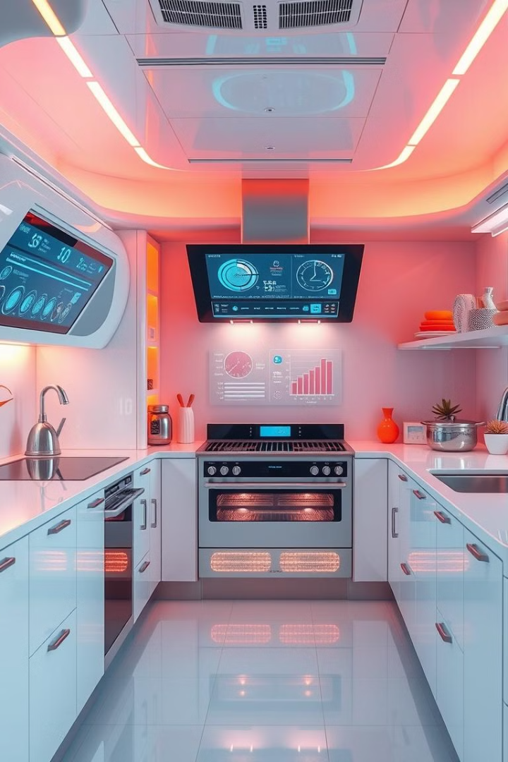
Title:-IOT-based Food Demand Prediction System
NAME-Asmita Kumari
UID-22BET10195
SECTION- 702
GROUPE-B

Slide 2
Introduction to IoT and its applications
What is IoT?
Applications :
The Internet of Things (IoT) refers to a vast network of physical devices, vehicles, home appliances, and other items embedded with sensors, software, and network connectivity, allowing them to collect and exchange data.
IoT is revolutionizing various industries, from smart homes and cities to healthcare and agriculture. It's driving efficiency, automation, and personalized experiences.

Slide 3



Importance of Food Demand Prediction
Reduce Food Waste
1
Accurate predictions help minimize overstocking, thus reducing food waste and its environmental impact.
Optimize Supply Chain
2
Predicting demand enables efficient inventory management, streamlining the supply chain and reducing costs.
Enhance Customer Experience
3
Meeting demand promptly ensures customer satisfaction and builds trust in the service.

Slide 4
Overview of the proposed system architecture
Sensors
1
Sensors collect real-time data on factors influencing food demand, such as temperature, humidity, and customer traffic.
Data Processing
2
Collected data is preprocessed and analyzed to extract meaningful insights
for prediction.
Machine Learning
3
Machine learning algorithms are trained on historical data to generate accurate demand forecasts.
IoT Platform
4
The IoT platform integrates all components, enabling communication and data exchange for real-time predictions.

Slide 5
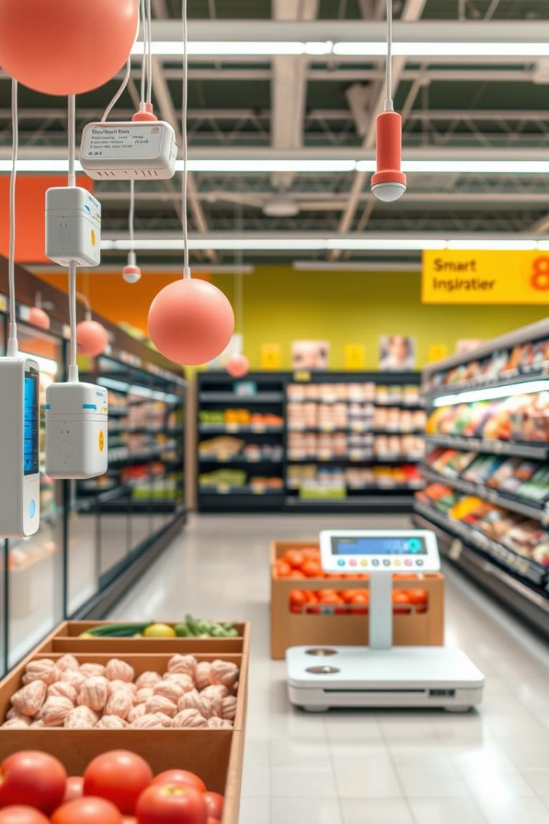



Sensor data collection and preprocessing
Sensors
Data Collection
Sensors like temperature sensors, humidity sensors, and customer traffic counters collect data relevant to food demand.
Data is collected in real-time and transmitted to the central processing unit via wireless networks.
Preprocessing
Data is cleaned, filtered, and transformed to remove inconsistencies and prepare it for analysis.

Slide 6

Machine learning algorithms for demand prediction
1
Regression Analysis
2
Time Series Analysis
Predicts demand based on relationships between historical data and external factors.
Analyzes trends and patterns in historical demand data to predict future demand.
3
Neural Networks
Complex models that learn from data and adapt to changing demand patterns.

Slide 7




Integration of prediction model with IoT platform
Model Deployment
Data Integration
Real-time Predictions
The trained prediction model is deployed on the IoT platform, making it accessible for real-time predictions.
The model receives sensor data from the IoT platform, allowing it to generate predictions based on current conditions.
The model provides accurate and timely predictions, enabling efficient inventory management and proactive decision-making.

Slide 8

Deployment and testing of the system
Pilot Deployment
Performance Evaluation
The system is initially deployed in a controlled environment to test its functionality and accuracy.
The system's performance is continuously monitored and evaluated to identify areas for improvement.
User Feedback
Feedback from users and stakeholders helps refine the system and improve its usability.

Slide 9
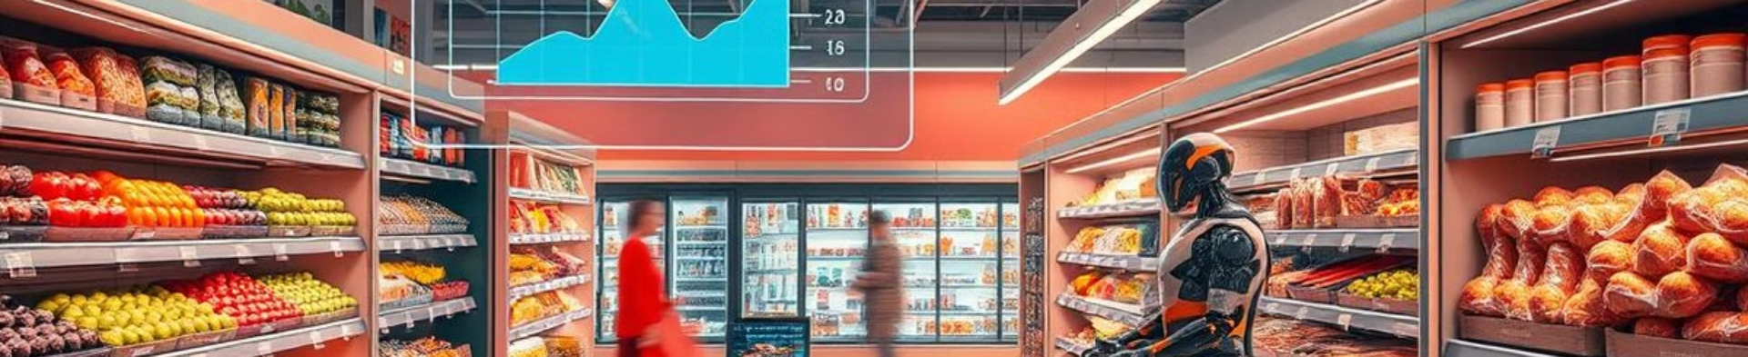
Conclusion and future enhancements
This system represents a significant step towards efficient and data-driven food management. Future enhancements include integrating with other systems like point-of-sale (POS) data and exploring advanced machine learning techniques for even more accurate predictions.Ai -Based food demand prediction system is about using artificial intelligence to guess how much food people will need in the future. The project is about using AI to make food distribution smarter, saving time, money & resources, while ensuring no one runs out og foods.

